Slide 1
UVACoupon
-Local information
CS 6750 Database Systems - Project Presentation 1
Team Members: Mengyu Gong, Jingyi Luo, Kai Luo, Weihan Lyu and Mengyao Zhang
January 31th, 2019

Slide 2
Topics
Business we want to model
Target users
Why we do this
How to implement our ideas
How we get data

Slide 3
Business we want to model
A lot of websites for nationwide discounts and coupons
How to get local discount information timely

Slide 4
Target users
UVA students
Local residents

Slide 5
Why we do this
Collect information to save time.
Local store need promotion.
We need a convenient way to get this information.

Slide 6
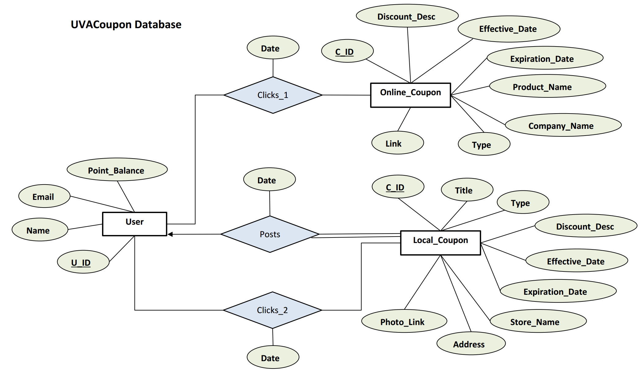
How to implement our idea

Slide 7



How we get data
Online coupons: web scraping from websites.
Local coupons: gather and post to the web application we create.

Slide 8
Thank you.

